Slide 1

What’s important this week

Slide 2
Duplicate as needed
Top Performers
Recognizing this week's lifecase production, bonus eligibility, and council credit progress
1
[Agent Name]
7
[Agent Name]
[Achievement - e.g., lifecases, bonus earned, council credits]
[Achievement - e.g., lifecases, bonus earned, council credits]
2
[Agent Name]
8
[Agent Name]
[Achievement - e.g., lifecases, bonus earned, council credits]
[Achievement - e.g., lifecases, bonus earned, council credits]
3
[Agent Name]
9
[Agent Name]
[Achievement - e.g., lifecases, bonus earned, council credits]
[Achievement - e.g., lifecases, bonus earned, council credits]
4
[Agent Name]
10
[Agent Name]
[Achievement - e.g., lifecases, bonus earned, council credits]
[Achievement - e.g., lifecases, bonus earned, council credits]
5
[Agent Name]
11
[Agent Name]
[Achievement - e.g., lifecases, bonus earned, council credits]
[Achievement - e.g., lifecases, bonus earned, council credits]
6
[Agent Name]
12
[Agent Name]
[Achievement - e.g., lifecases, bonus earned, council credits]
[Achievement - e.g., lifecases, bonus earned, council credits]
Concrete wins. Keep the momentum going.
Notes:
PRESENTER: This is a reusable placeholder. Before the meeting, duplicate this slide as needed and replace the bracketed text with this week's honorees - names, lifecase counts, bonuses earned, and council credit milestones. Recognition is the cheapest retention tool we have; be specific and be generous. Delete any unused rows.

Slide 3
Market Week Overview
Week ended Thursday, July 2, 2026
Week Ahead: July 6 - July 10, 2026
Notes:
Set the frame. The holiday-shortened week ended Thursday with the Dow at a record close and a surprisingly weak June jobs report. Markets were closed Friday, July 3 for Independence Day. This week attention shifts to the Fed: Wednesday's minutes are the first from a meeting run by new Chair Kevin Warsh. Keep this section to 8-10 minutes total.

Slide 4
Week in Review: U.S. Markets Overview
A record Dow, a late tech wobble, and a soft jobs number to close the week.
Dow closed Thursday at a record 52,900.07, up about 2% for the holiday-shortened week.
S&P 500 finished at 7,483.23, up roughly 1.8% for the week and about 9% year to date.
Nasdaq advanced for the week despite a Thursday chip selloff: Micron -7%, AMD -4.3%, Marvell -9.8%.
Small and mid caps lagged: the Russell 2000 and S&P MidCap 400 both declined for the week.
Communication services, financials, and consumer discretionary led; real estate, utilities, and energy fell.
Plain English
Big U.S. companies had a strong week and the Dow set a record, but smaller companies fell behind and tech turned shaky Thursday. The strength is real; it is just not evenly spread.
Internal use only. For agent use only. Not for use with the public.
ELEVATE
NEW ORG
Notes:
Walk the numbers left to right, then hit the Plain English box. Key story: the week started with a tech relief rally (Nasdaq +2.07% Monday alone), the Nasdaq just wrapped its strongest quarter since 2020, and then Thursday flipped the script - a weak jobs report sent the Dow to a record while chip names sold off hard. Emphasize the breadth problem: small caps declined while the Dow set records. That concentration is the honest caveat to an otherwise good week. Weekly figures are computed from daily closes reported by TheStreet and CNBC; markets were closed Friday, July 3.

Slide 5
Key Economic Data Released Last Week
One report mattered: June payrolls came in weak.
June payrolls: +57,000 jobs vs. roughly 110,000 expected - the softest reading since February.
Unemployment rate ticked down to 4.2% from 4.3%.
The miss quieted talk of a Fed rate hike; the Dow rallied 1.14% to a record close on the news.
Context: inflation has run above the Fed’s 2% goal for over five years, driven lately by energy costs.
Fed Chair Kevin Warsh in June: “Persistently high prices are a burden for the American people.”
Internal use only. For agent use only. Not for use with the public.
ELEVATE
NEW ORG
Notes:
Plain-English version for the room: hiring slowed a lot in June. Strangely, stocks liked that, because slower hiring makes the Fed less likely to raise rates. Slower jobs plus high prices is exactly why planning beats predicting. The counterintuitive move is the teaching moment: bad jobs news, record Dow close. Explain the mechanism - this market has been worried about rate HIKES because inflation is running hot on energy costs, so a soft labor print reduces that pressure. Do not oversell one month of data; 57,000 is one soft reading, not a recession call. Source: Labor Department June employment report released Thursday, July 2; reaction per TheStreet and Kiplinger.

Slide 6
Notable Earnings from Last Week
Nike headlined a quiet pre-holiday reporting week.
Nike’s fiscal Q4 (reported June 30) was the week’s cleanest story - and a lesson in reading past headlines.
Nike FQ4 revenue
Reported EPS
Greater China
$11.0B
$0.72
-12%
Down 1% y/y, but above estimates
Includes $0.52 one-time tariff recovery
Weak, though ahead of expectations
Talking point: Nike’s $0.72 EPS crushed the $0.13 estimate, but $0.52 of it was a one-time tariff-recovery benefit, not better sneaker sales. The stock whipsawed after hours for exactly that reason. Constellation Brands, General Mills, and FactSet also reported during the shortened week.
Internal use only. For agent use only. Not for use with the public.
ELEVATE
NEW ORG
Notes:
Use Nike as a client-education story: headline EPS of $0.72 versus a $0.13 estimate looks like a monster beat, but the bulk came from an expected recovery of IEEPA tariffs - an accounting benefit worth about 52 cents and roughly 900 basis points of gross margin. Underlying revenue fell 1% and Greater China fell 12%. Lesson for clients and new agents alike: one number never tells the story. Source: Nike FY26 Q4 release and CNBC, June 30.

Slide 7
Economic Reports Calendar: Week Ahead
July 6-10: a light calendar with one big exception - the Fed minutes.
Date
Report
Time (ET)
Why it matters
Mon 7/6
ISM Services PMI; S&P Global Services PMI (June)
10:00 am / 9:45 am
Health of the service economy.
Tue 7/7
Trade Balance (May)
8:30 am
Trade flows feed Q2 GDP math.
Wed 7/8
FOMC Minutes (June meeting); Consumer Credit
2:00 pm / 3:00 pm
First minutes of the Warsh Fed.
Thu 7/9
Jobless Claims; Existing Home Sales (June)
8:30 am / 10:00 am
Layoff watch after weak payrolls.
Internal use only. For agent use only. Not for use with the public.
ELEVATE
NEW ORG
Notes:
Wednesday is the event. Chair Warsh scrapped forward guidance and skipped the dot plot, so the June meeting minutes are the market's best window into how the committee is weighing energy-driven inflation against a cooling labor market. Thursday's jobless claims get extra attention after the weak June payrolls number - claims are the fastest early warning if hiring weakness turns into firing. Friday has no noteworthy releases. Source: Kiplinger weekly economic calendar.

Slide 8
Earnings Calendar: Week Ahead
A quiet setup week - Q2 reporting season kicks off with the banks the week after.
Date
Company
Consensus
Why watch
Tue 7/7*
Levi Strauss (LEVI)
Q2 report expected; date tentative
Apparel / consumer discretionary read
Thu 7/9*
Conagra Brands (CAG)
Fiscal Q4; date tentative
Food costs and consumer trade-down
Fri 7/10
Delta Air Lines (DAL)
EPS est. ~$1.43 vs. $2.10 a year ago
Travel demand vs. ~$4.30/gal fuel
Wk of 7/13
JPMorgan and the big banks
Q2 season kickoff
Sets the tone for financials
Internal use only. For agent use only. Not for use with the public.
ELEVATE
NEW ORG
Notes:
Early July is the calm before earnings season. Delta on Friday is the marquee report: consensus is around $1.43 EPS, down sharply from $2.10 a year ago, with management guiding to low-teens revenue growth and a 6-8% operating margin against roughly $4.30/gallon fuel. The stock is up about 47% in three months, so expectations are elevated. Dates marked * are tentative and should be confirmed. The real Q2 test starts the following week when the big banks report. Sources: Barchart, Seeking Alpha, company IR pages.

Slide 9
Fed, Rates & Macro Watch
A new Fed chair, no forward guidance, and energy-driven inflation.
The Warsh Fed paused in June with inflation above the 2% goal for a fifth straight year, driven lately by energy costs.
Forward guidance is gone and Warsh skipped the dot plot, so Wednesday’s minutes carry unusual weight.
The weak June jobs report has quieted rate-hike talk - for now.
NYLIM’s macro team describes the backdrop as “more volatile and more headline-driven,” with geopolitics a growing headwind even as tech delivers.
NYLIM also notes private-credit stress headlines miss the fuller story: institutional demand remains robust and credit fundamentals healthy.
Advisor angle
Clients hear “rate hike” and “record high” in the same newscast. Your value is translating noise into a plan. Guarantees and diversification both earn their keep in weeks like this.
Internal use only. For agent use only. Not for use with the public.
ELEVATE
NEW ORG
Notes:
This is the macro regime slide. Key differences from the past decade: the fear is rate hikes, not cuts, because energy costs have kept inflation above target; and the new chair has deliberately removed the market's usual signals (forward guidance, his dot-plot participation). That is why the minutes matter more than usual. Where possible, anchor language to NYLIM's published views: the June Macro Pulse ('Diplomacy Wavers; Tech Delivers') frames geopolitics as a daily headwind with tech earnings doing the lifting, and the June 28 GMS Weekly Macro Pulse pushes back on private-credit alarm. Sources: nylim.com/insights; Kiplinger Fed coverage.

Slide 10
Client Talking Points: What This Means for You
Plain-English language for client conversations.
Markets had a good, if choppy, holiday week. The Dow hit an all-time high, and big U.S. companies keep performing well.
Hiring slowed in June. That sounds like bad news, but it actually calmed fears that the Fed would need to raise interest rates.
Prices are still rising faster than anyone would like, mostly because of energy costs. That is the main thing the Fed is watching.
Technology stocks stumbled late in the week after a very strong run. Pullbacks like that are normal after big gains.
What to do: nothing dramatic. A diversified plan already assumes weeks like this. If your goals have changed, let’s talk. If not, stay the course.
Internal use only. For agent use only. Not for use with the public.
ELEVATE
NEW ORG
Notes:
Use this slide as a script. Calm and direct. Clients do not need index trivia; they need to know what happened, what to watch, and why their plan does not need to be rebuilt around one week of headlines. If a client pushes on the weak jobs number, acknowledge it honestly - one soft month is worth watching, not panicking over - and pivot to what protection and guarantees are for. Keep the tone of a trusted advisor: warm, unhurried, specific.

Slide 11
New Org: What’s important week of July 6
Notes:
New Org Section: For SPs and Partners presenting to New Org agents. These slides are visible to EPs and MPs.

Slide 12


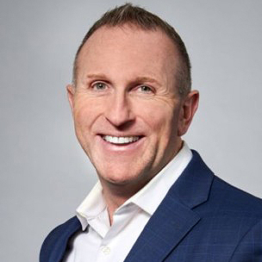
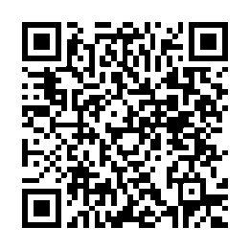
Start 3Q with timely reasons to connect
A national PLAN webinar for a solid Council start
Featured speakers:
Date: Wednesday, July 8, 2026
Time: 3 pm ET*
Build momentum early in the third quarter with practical strategies, timely updates and resources you can use to support meaningful client conversations.
Timely information to support client outreach
Strategies and resources to help build 3Q activity
Latest DCA updates for client conversations
DCA strategies and language from an expert DCA agent
Sonali Virendra
Senior Vice President and
Head of Agency
Daryl Havrish
Executive Council
Chicago North Shore GO
Register today
Scan the QR code to reserve your spot.
*2 pm CT, 1 pm MT, 12 pm PT, 11 am Alaska, 9 am Hawaii
Notes:
Start 3Q with Timely Reasons to Connect
This national PLAN webinar is designed to help agents build momentum early in the third quarter through purposeful activity and relevant reasons to connect with clients. Attendees will gain practical strategies, timely updates and valuable resources that can support client outreach and meaningful conversations.
The session will highlight ideas for identifying opportunities, increasing 3Q activity, important DCA updates and positioning strategies, and leveraging available resources in client discussions. Agents will also receive important updates and actionable next steps to help maintain momentum and support a strong start to the quarter.
Contact: PLAN@newyorklife.com
Registration link: https://nylife.zoom.us/webinar/register/WN_orBUFdlRQqCo8q-UoIxNBA

Slide 13


NEW ORG AGENTS
Tier 1
July Growth Bonus
Initial Bonus Level
Bonus
$250
Pay for 3 life cases in the month of July.
Qualify for a cash bonus based on paid life cases in the month of July¹.
Tier 2
Double Your Bonus
Includes
Life (EWL 3:1)
Double
$500
Grow by 1 life case over July 2025, with a minimum of 5 life cases to double your bonus.
Excludes
VUL/MWP
COLI/BOLI
Policies issued in New York State
New York State Provision: Agents who meet the qualifications with paid life cases issued in New York State will receive bonus Council Credits in lieu of a cash bonus.
¹Agents eligible to enroll in the Life and Annuity Expense Allowance Program must enroll by July 31, 2026, to receive a cash bonus.
Pending NYS Dept. of Financial Services approval.
Notes:
Contact: PLAN@newyorklife.com
Info Central Page: https://www.today.newyorklife.com/agencyportal/s/article/July-Growth-Bonus

Slide 14

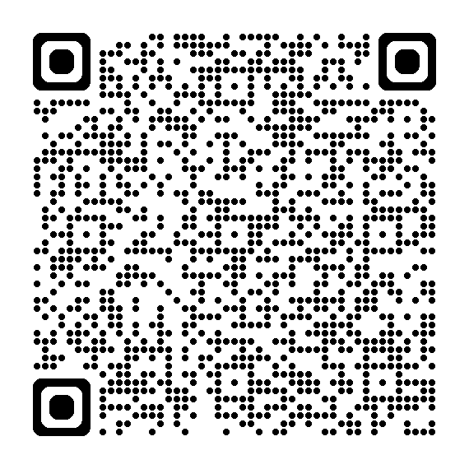
Executive Council Rocky Mountain Crocs™ Giveaway Experience
COUNCIL PERKS
Exclusive Denver giveaway for top-performing Executive Council agents
Be among the top 200 agents on the paid insurance solution cases¹ leaderboard and qualify for an exclusive invitation to the Executive Council Rocky Mountain Crocs™ Giveaway Experience at the Executive Council Meeting on Tuesday, August 25.
Highlights
Qualification period: July 1 – August 14
Open to 2026 Executive Council qualifiers
Rank in the top 200 on the paid insurance solution cases¹ leaderboard
Must attend 2026 Executive Council meeting to receive prize
Registered guests may attend
Choose a complimentary Crocs bag adorned with a custom NYL JibbitzTM charm. Personalize it with your choice of two additional charms!
Scan the QR code for complete rules, requirements, qualifying products, and official incentive details.
Notes:
¹ Includes Life (EWL 3:1) LTCi, and DI. Excludes VUL/Market Wealth Plus, Annuity and COLI/BOLI products, DIOP and Group Insurance cases. LTCi excluded in Delaware State.
=============================================================
Executive Council Rocky Mountain Crocs™ Giveaway Experience – Open to 2026 Executive Council agent qualifiers.
Compete with your Executive Council peers from July 1 through August 14.
Agents who finish in the top 200 on the paid insurance solution cases leaderboard will qualify for an exclusive invitation for themselves and their registered guests to the Rocky Mountain Crocs Giveaway Experience at the Executive Council Meeting on Tuesday, August 25 in Denver, Colorado
Incentive-eligible solutions Include: Life (EWL 3:1) LTCi, and DI cases paid between July 1 and August 14.
Excludes: annuities, VUL/Market Wealth Plus and DIOP. LTCi excluded in Delaware State.
The experience encompasses your choice of one complimentary Crocs bag, either a tote or backpack, a custom New York Life Jibbitz charm, and two additional charms selected from the Jibbitz Bar. Registered guest are invited to participate in the experience.
Qualifying agents must attend the Executive Council Meeting to patriciate.
Contact: PLAN@newyorklife.com
Info Central Page: https://www.today.newyorklife.com/agencyportal/s/article/Council-Perks-Executive-Council-Rocky-Mountain-Crocs-Giveaway-Experience

Slide 15

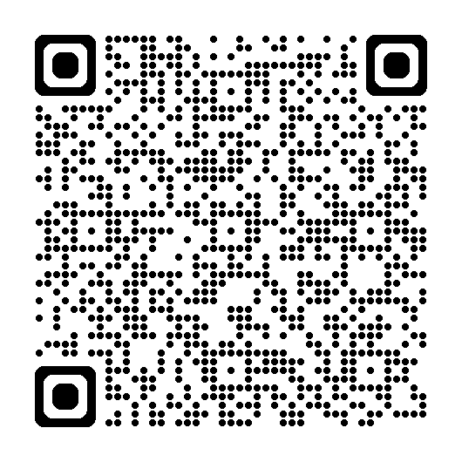
President's Council Beachfront Boutique Experience
COUNCIL PERKS
Private shopping event for top-performing President's Council agents
Be among the top 100 President's Council agents on the 3Q paid insurance solution premium¹ leaderboard and qualify to receive a retail credit² to spend at a private New York Life shopping event at the President’s Council meeting on October 6 and 7. Top 10 will also qualify for a Balinese-inspired premium chickee hut rental on October 7!
Highlights
Qualification period: July 1 – September 30
Open to 2026 President's Council qualifiers
Rank in the top 100 on the paid insurance solution premium¹ leaderboard
Must attend 2026 President's Council meeting to receive prize
Must be prorata proactive by September 30
Registered guests may attend
Top 10 also qualify for a premium Balinese-inspired chickee beach hut rental*
Scan the QR code for complete rules, requirements, qualifying products, and official incentive details.
*Pending NYS Dept. of Financial Services approval.
Notes:
¹ Includes Life, LTCi, and DI. Recurring base premium and riders are calculated at 100%; OPP and single premium policies are calculated at 10%. Excludes premium from Annuity and COLI/BOLI products, DIOP and Group Insurance cases and LTC in DE state.
² $300 retail credit
====================================================
President's Council Beachfront Boutique Experience – Open to 2026 President’s Council agent qualifiers
Compete with your President’s Council peers during the Third Quarter of 2026 (July 1 – September 30)
Agents who finish in the 100 on the 3Q paid insurance solution premium leaderboard will qualify to receive a retail credit to spend at a private New York Life shopping event at the President’s Council meeting on October 6 & 7.
The top 10 will also qualify for a premium chickee hut rental on October 7!
Includes Life, LTCi, and DI. Recurring base premium and riders are calculated at 100%; OPP and single premium policies are calculated at 10%
Excludes premium from Annuity and COLI/BOLI products, DIOP and Group Insurance cases and LTC in DE state.
Agents must be prorata proactive by September 30.
The experience encompasses an elevated retail shopping event with a $300 retail credit, complete with refreshments and private access to the resort's premier ladies and gentlemen’s boutiques, Sweet Waters and Cross Winds. Browse stylish women's apparel, swimwear, and accessories from brands such as Lilly Pulitzer®, lululemon®, Versace®, and Gucci®, or explore the latest men's fashion and accessories from designers including BUGATCHI®, Tommy Bahama®, Maui Jim®, Ray-Ban®, and lululemon®. Personal shoppers will also be available to help agents make the most of their experience.
The top 10 leaderboard agents will also qualify for a premium chickee hut rental on the JW Marriott’s breathtaking beach on Wednesday, October 7. This Balinese-inspired shaded retreat accommodates up to six guests and is ideally located between the beach and pool. Rental includes a queen daybed, chairs, and towel service.
Qualifying agents must attend the President’s Council Meeting to receive the retail credit and chickee hut rental.
Contact: PLAN@newyorklife.com
Info Central Page: https://www.today.newyorklife.com/agencyportal/s/article/Council-Perks-President-s-Council-Beachfront-Boutique-Experience

Slide 16
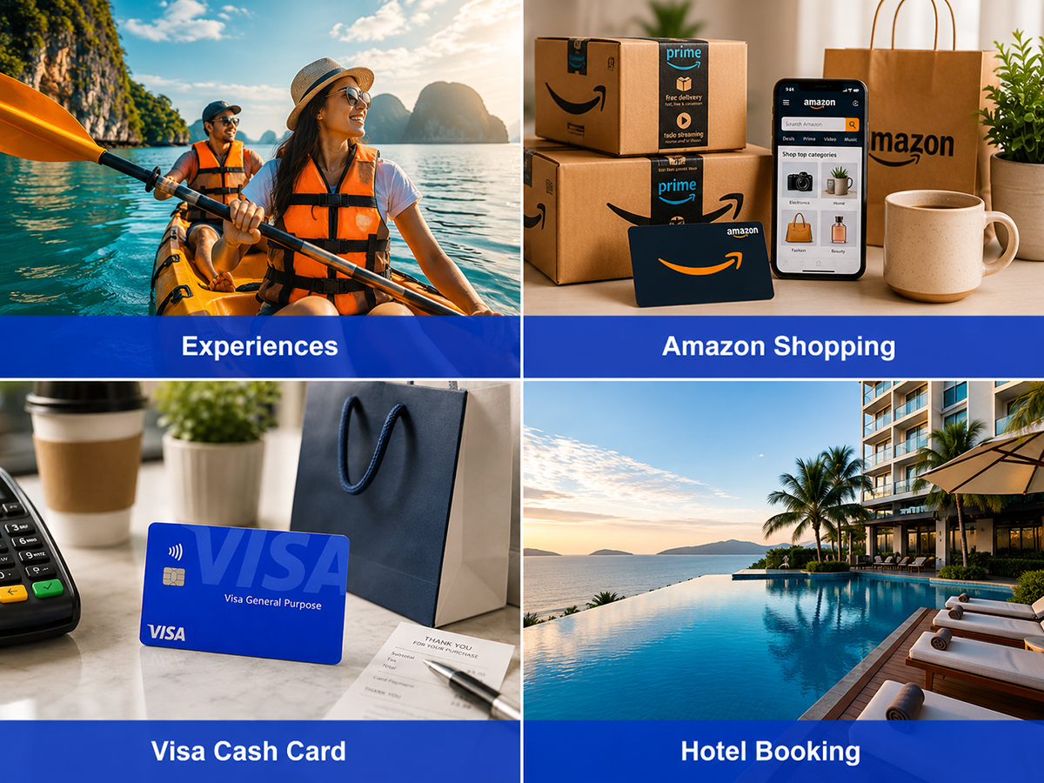
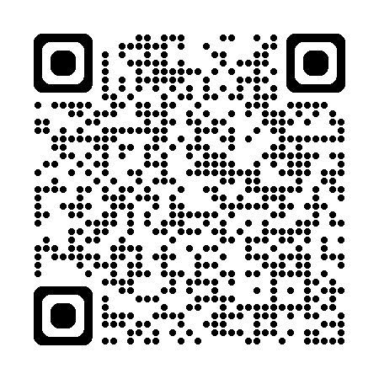
Awards Your Way
A new choice-based incentive program for Council agents
Open to 2026 Council agents (QC & higher)¹
Qualification period: July 1 – December 31, 2026
A digital rewards marketplace where agents choose from travel, merchandise, gift cards, tickets, and experiences.
Points are awarded through insurance production, growth and designations.
Agents must opt in by September 30, 2026.
Scan the QR code to learn more about the new Awards Your Way recognition program on Info Central.
¹Agents eligible to enroll in the Life and Annuity Expense Allowance Program must enroll by July 31, 2026.
Pending NYS Dept. of Financial Services approval.
7
Notes:
Contact: PLAN@newyorklife.com
Info Central Page: https://www.today.newyorklife.com/agencyportal/s/article/Awards-Your-Way

Slide 17


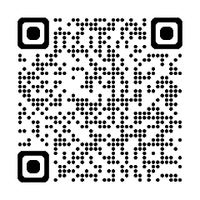

EWL Momentum Maker continues through July 31
Qualify for up to $3,000 for Employee’s Whole Life (EWL) new group activity!
Agents will receive a $600 credit for each EWL group that receives an arrangement number between May 1 and July 31, capped at 5 new groups
Dormant SI groups that convert to GI between May 1 – July 31, 2026, will be eligible
Group credit is awarded to the primary agent of record
Only groups that enroll and meet EWL application strength requirements by 9/30/26 will contribute to an agent’s EWL new group count
Growth Requirements Based on EWL new group activity during the prior-year period (May 1 – July 31, 2025)
0 new groups: Must establish a minimum of 2 new groups
1–4 new groups: Must establish at least 1 additional group
5+ new groups: Must establish 5 new groups during the incentive period
Requirements
Must be enrolled in EAP by 5/31/26
Bonuses credited via Life & Annuity Expense Allowance Plan (subject to NYS limits)
TAS Agents in AZ, CA, IL, IA, MT, NV, NH, ND, SD may qualify for TAS bonus
Scan the QR code to learn more about the EWL Momentum Maker sales incentive on Info Central.
Notes:
Cash bonuses are credited as part of the L&A Expense Allowance Plan (EAP) and subject to Conditional Check. In some instances, cash bonuses may be withheld when an agent has reached the maximum legal allowance under the Conditional Check formula. For more information, see Life and Annuity Expense Allowance Plan on Info Central.
TAS agents on the Allowance Builder XP TAS Plan in GOs located in AZ, CA, IL, IA, MT, NV, NH, ND, and SD who are not eligible to enroll in EAP may be eligible for a cash bonus as a one-time payment through TAS, subject to TAS limits.
Contact: PLAN@newyorklife.com
Info Central Page: https://www.today.newyorklife.com/agencyportal/s/article/EWL-Momentum-Maker

Slide 18

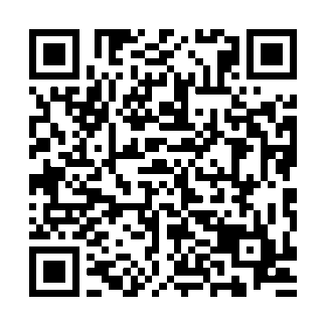
3Q 2026 Registered Rep MasterClass
Session 1 NYLIFE Securities and Mutual Funds July 14
Session 2 Variable Annuities, What You Need to Know July 21
Session 3 Positioning IndexFlex July 28
Session 4 Variable Annuity Riders August 4
Session 5 Working in the Rollover Market August 11
Session 6 Positioning VUL August 18
Session 7 Understanding IRA Opportunities August 25
Session 8 Annuity New Business and Suitability September 1
Session 9 Small Business Solutions September 8
Session 10 Morningstar: Researching Funds September 15
Strengthening the foundation
10-part quarterly series - Tuesdays at 3pm EST
Educates on NYL products
Interactive sessions with product experts
Provides ongoing education
Register today to ensure prompt access to these highly anticipated events.
Events start at 3pm ET and run 60 minutes.
Notes:
3Q 2026 Registered Rep MasterClass
Starting Tuesday July 14 at 3pm EST running for 10 weeks
Contact: PLAN@newyorklife.com
Registration link: https://nylife.zoom.us/webinar/register/WN_Wm0kOIhQTUG-ZypKnrJrVQ#/registration

Slide 19

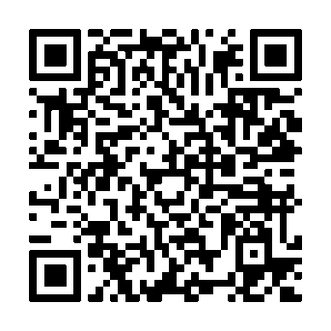
3Q Life Fundamentals Series
Strengthening the foundation for confident life insurance conversations
Life Insurance
7/14 | Session 1 | Term Life Overview and Key Concepts
7/21 | Session 2 | Integrating WL into Planning Guest Speaker: Allen Hensley
7/28 | Session 3 | Whole Life Product Overview & Riders
8/4 | Session 4 | Whole Life Key Sales Concepts: SLIRP, BOWL, & FIR
8/11 | Session 5 | Variable Universal Life Product Overview & Key Concepts
8/18 | Session 6 | Universal Life Product Overview & Key Concepts
8/25 | Session 7 | Universal Life Product Case Study Live Demonstration
7-part quarterly series (Tuesdays)
Educates on NYL life products
Interactive sessions with product experts
Provides ongoing education
Open to agents and managers
Register today to ensure prompt access to these highly anticipated events.
Events start at 1 pm ET* and run for 60 minutes.
*12 pm CT, 11 am MT, 10 am PT, 9 am Alaska, 7 am Hawaii
Notes:
3Q Life Fundamentals Series
The 3Q Life Fundamentals Series is a seven-session program designed to build confidence and strengthen foundational life insurance knowledge. Sessions are held every Tuesday at 1:00 PM ET and cover key product concepts, sales strategies, and practical applications across the life insurance portfolio.
Led by product experts, the series is open to agents and managers looking to expand their product expertise and enhance client conversations. Each session is 60 minutes, and registration is available through the QR code.
Registration link: https://nylife.zoom.us/webinar/register/WN_4__InmH2QIqT5801tAJuKg

Slide 20

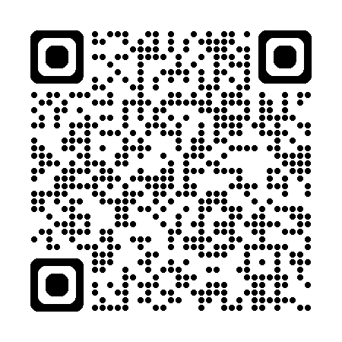
Target Markets Upcoming Webinars
Chinese Market Monthly SIE Study Group Sessions
Monday, July 6, 4 pm ET
Chinese Market will conduct a series of SIE tutorial sessions based on STC study material. All sessions will be conducted primarily in Mandarin Chinese and English.
Scan the QR code to register for Monthly SIE Study Group Sessions
Notes:
Chinese Market Monthly SIE Study Group Sessions
(for New Org, Estab and Second Line Managers)
Chinese Market will conduct a series of SIE tutorial sessions based on STC study material. All sessions will be conducted primarily in Mandarin Chinese and English.
Contact: targetmarkets@newyorklife.com
Register: https://nylife.zoom.us/meeting/register/a4UI1WqPQOKCBm1JCZqQoA
Submitted by: John Macchia

Slide 21
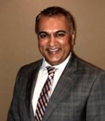
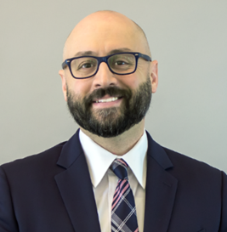
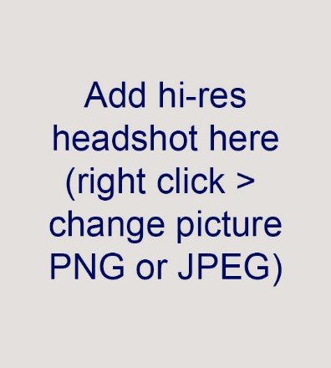
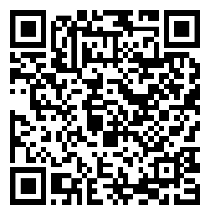
NYLIFE Securities Essentials Webinar
"Introduction to Wealthscape"
Date: Wed., July 15, 2026 Time: 2 pm ET
Featured speakers
Join Product Experts to learn how to navigate Wealthscape's basic features and tools to effectively service your clients' brokerage accounts. Live Q&A included.
Samir Parikh
Investor Relations
NYLIFE Securities
Brian Davis
Product
NYLIFE Securities
Add QR code here
Scan the QR code to register for this event or webinar.
Notes:
NYLIFE Securities Essentials webinar: “Introduction to Wealthscape”
Join Product experts to earn how to navigate Wealthscape's basic features and tools to effectively service your clients’ brokerage accounts.
All agents welcome and webinar replay included.
Wed., July 15th, 2-3pm ET
Register Here:
Contact: anna_m_fidz@newyorklife.com or nylsecproduct@newyorklife.com
SMRU: 8706133.1 One time Use Only.

Slide 22
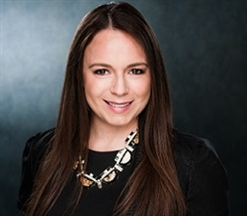
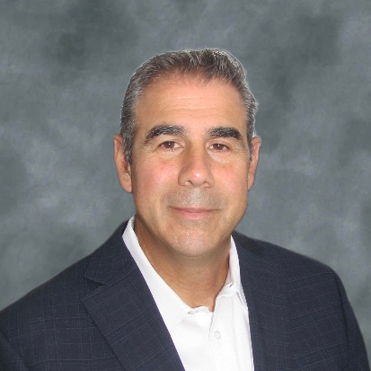
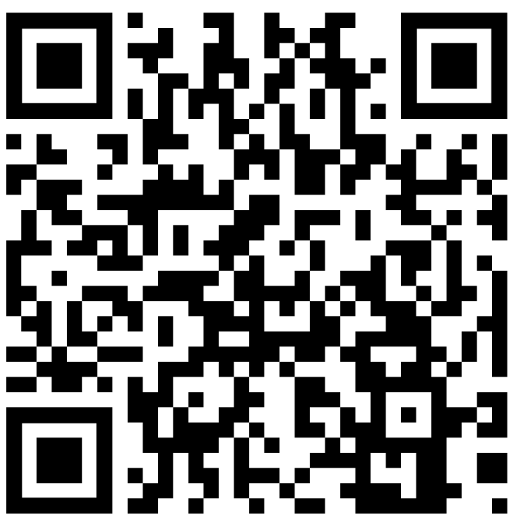
Join us July 8 for the new agent educational call
How to present solutions and handle objections
Featured speakers
Date: Wednesday, July 8, 2026 Time: 1 pm ET
Learn how to:
present recommendations clearly and concisely
support solutions with data and examples
listen carefully to objections
respond with confidence and professionalism
focus on solutions, not challenges
Lyndsey Jackson, MBA
RICP®, ChFC®, CLU®, CLTC® Senior Associate
National Development Faculty​
Nicola (Nick) D’Ambrosio
Registered Representative
Nassau GO
Scan the QR code to register for this event or webinar.
Notes:
Your name and email address 1-2 sentences about the slide. Hyperlinks

Slide 23

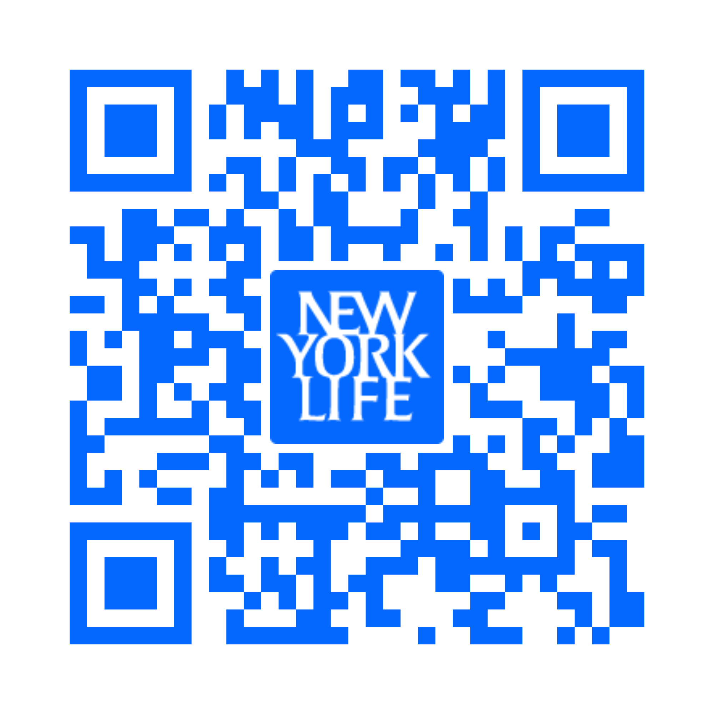
Golden Futures Awards Program
Deadline is July 31, 2026
Use Marketing Central to promote the Golden Future Awards today through July 31st:
Email (ID: 3246498)
Social Post (ID: 3184567)
$100,000 in awards available for kids ages 5 through 16 nationwide:
50 $1,000 awards for kids 5-10
50 $1,000 awards for kids 11-16
Scan the QR code for more details on Info Central.
Notes:
Contact: Debbie Gassaway debra_Gassaway@newyorklife.com Message: Last chance to promote the Golden Futures Awards program.
Deadline 7/31/26
Info Central: https://www.today.newyorklife.com/agencyportal/s/sales-and-marketing/marketing-and-branding/local-event-marketing

Slide 24
This Week’s Training
Building Referral Relationships with Attorneys, CPAs, and Other Centers of Influence
30-minute training for New Org agents | Week of July 6
New Orleans General Office
FOR INTERNAL USE ONLY. NOT FOR USE WITH THE GENERAL PUBLIC.
Notes:
Transition slide - announce the shift from market update to training. Setup line: 'Every one of you is one relationship away from a referral pipeline that outproduces any seminar or cold list. Today we build it.' This session draws on practice-management research from Kitces, Hartford Funds, Horsesmouth, and Orion, plus the video resource shared in the topic folder (youtu.be/9saPh9tF0TE). Approximately 30 minutes: 12 content slides, about 2 minutes each, plus discussion.

Slide 25
Why COIs beat every other prospecting channel
New York Life
A referral from a professional arrives pre-endorsed. Nothing else you do compares.
Trust transfer
Case quality
Compounding leverage
A client’s CPA or attorney is already their most trusted advisor. When that person says “call Dave,” the prospect arrives with their guard down and their mind open.
COI referrals skew toward complex, higher-value cases - business owners, estates, tax problems - because that is who CPAs and attorneys serve every day.
One good CPA relationship can send you referrals for years. A seminar produces one weekend. Build assets, not events.
Coach line: You are not asking for favors. You are building a professional supply chain.
FOR INTERNAL USE ONLY. NOT FOR USE WITH THE GENERAL PUBLIC.
1
Notes:
Open with the math: most advisors chase transactions (a seminar, a call night) while top advisors build referral assets. Ask the room: 'Who here has ever gotten a client from a CPA? How did it happen?' Let one or two answer - it was almost never cold. Key point: the trust a client places in their CPA transfers to you at introduction, which is why COI referrals close faster and stick longer than any other source.

Slide 26
Why most advisors fail with COIs
New York Life
The graveyard is full of advisors who took a CPA to lunch once and waited.
They lead with the ask
They sound identical
They don’t follow through
“Send me your clients” is the fastest way to end the relationship. The CPA has heard it a hundred times and owes you nothing.
To a CPA, most advisors are interchangeable: same pitch, same brochure. If you cannot say what you do differently, why would they risk their reputation on you?
One lunch is not a strategy. COI relationships are built on repeated, useful contact over months - most advisors quit after the first touch.
Coach line: The CPA has heard “send me your clients” a hundred times. Be the one who never says it.
FOR INTERNAL USE ONLY. NOT FOR USE WITH THE GENERAL PUBLIC.
2
Notes:
This slide is about differentiation through behavior, not marketing. Emphasize the reputational risk a COI takes when referring: a CPA who sends a client to a bad advisor damages a 15-year client relationship. That is why they default to no. Everything in the next ten slides is designed to lower that perceived risk. Discussion question: 'What would it take for YOU to refer your best client to someone?'

Slide 27
Know what the COI actually wants
New York Life
Enter their world before you invite them into yours.
CPAs: protection
Attorneys: execution
Both: reciprocity
CPAs are risk-averse by profession. They fear a bad handoff more than they want a fee split. They want competence, communication, and zero surprises with their client.
Estate and business attorneys draft documents that die without funding. They want an advisor who gets policies issued, beneficiaries right, and trusts funded - on time.
Professionals building their own book want referrals too. Younger partners and solo practitioners are hungriest - and most open to a new advisor relationship.
Coach line: The question is never “what can they send me.” It is “what problem of theirs can I solve.”
FOR INTERNAL USE ONLY. NOT FOR USE WITH THE GENERAL PUBLIC.
3
Notes:
Tailor the approach by profession. CPAs think in risk and accuracy; show them process. Attorneys think in execution; show them completed work - an insurance policy that funds a buy-sell agreement is their document brought to life. Practical tip from the research: target professionals who are actively building their practices (younger partners, new solo shops) rather than established names who already have advisor relationships locked in.

Slide 28
Step 1: Start inside your own book
New York Life
Your next COI relationship is hiding in your top 20 client files.
Inventory your top 20
The ask, verbatim
Get the introduction
List your best 20 clients - the ones you wish you had more of. For each, identify their CPA and attorney. If you don’t know, that is your opening.
“Everything looks on track, but I noticed I don’t have your CPA’s information. When we make decisions with tax consequences, I want to coordinate with them so nothing falls through the cracks.”
Ask the client’s permission to introduce yourself. A warm intro through a shared client is a meeting; a cold call to a CPA is a voicemail.
Coach line: The shared client is the bridge. Walk across it.
FOR INTERNAL USE ONLY. NOT FOR USE WITH THE GENERAL PUBLIC.
4
Notes:
This is the highest-percentage play in the entire strategy, straight from the Kitces research: deepen relationships with the CPAs of your EXISTING clients, where a natural introduction already exists. Homework assignment starts here: everyone lists their top 20 clients this week and captures COI names for each. Role-play the verbatim script with the room - it is a service statement, not a sales ask, which is why clients say yes.

Slide 29
Step 2: The first conversation
New York Life
You are calling about the shared client - not about referrals.
The frame
The language
The exit
This is a professional courtesy call between two advisors who serve the same person. Referrals are not mentioned. At all.
“I want to make sure what I’m doing on the insurance and investment side doesn’t create problems on your side. Can I walk you through what we’ve put in place for [client]?”
End with a concrete reason to talk again: a joint year-end review, a document they need, a tax question you will bring them. No open-ended “let’s stay in touch.”
Coach line: The first meeting has one goal - a second meeting with a date on it.
FOR INTERNAL USE ONLY. NOT FOR USE WITH THE GENERAL PUBLIC.
5
Notes:
Walk through a live example. The call is short, professional, and entirely about the client. This does two things: it demonstrates competence (you coordinate; most advisors don't) and it gives the COI a risk-free sample of working with you. Warn the room: the moment you pivot to 'so, do you ever refer clients out?' in call one, you have become every other advisor who ever bought them coffee.

Slide 30
Step 3: Demonstrate, don’t describe
New York Life
COIs refer based on what they have seen you do, not what you say you do.
Send work product
Run a joint review
Be easy
After tax-sensitive decisions, send the CPA a one-page summary: what was done, why, and the tax relevance. You just became the easiest advisor they work with.
Propose one meeting a year with you, the client, and the CPA or attorney together. Watching you work in front of their client is worth fifty lunches.
Return calls same day. Send organized files. Hit deadlines. Boring reliability is the single most-cited reason COIs keep referring.
Coach line: Every piece of work you share is an audition you did not have to ask for.
FOR INTERNAL USE ONLY. NOT FOR USE WITH THE GENERAL PUBLIC.
6
Notes:
This is where trust is actually built. The one-page decision summary is a differentiator almost nobody uses - it takes ten minutes and permanently changes how the CPA sees you. Compliance note: get client authorization before sharing any client information with their other advisors, and keep summaries factual. The joint review meeting also deepens YOUR client relationship - clients love seeing their advisors coordinate.

Slide 31
Step 4: Give first
New York Life
The fastest way to receive referrals is to send them.
Refer first
Send useful material
Make them look good
You meet people with tax and legal needs every week. Send them - with a warm intro and a follow-up. Reciprocity is the oldest law in professional services.
Forward relevant insights - a NYLIM market piece, a tax-change summary - with one line on why it matters to their clients. Useful beats frequent.
Invite them to present at your client events. Quote their guidance to shared clients. A COI who looks smart because of you stays close to you.
Coach line: Keep score privately, give publicly. The ledger balances faster than you think.
FOR INTERNAL USE ONLY. NOT FOR USE WITH THE GENERAL PUBLIC.
7
Notes:
Reciprocity is the engine of this whole system. Practical exercise: ask each agent to name one client or prospect in the last 90 days who needed a will, a trust, or tax help - that was a referral they could have given. Establish the habit: every referral you send gets a warm email introduction and a one-week follow-up. Track what you give; you will be surprised how quickly it comes back.

Slide 32
Step 5: Formalize the pipeline
New York Life
Turn goodwill into a working system.
Define your ideal client
Agree on the handoff
Set a cadence
Tell the COI exactly whom to send: “Business owners thinking about succession” beats “anyone who needs financial planning.” Specific is memorable; vague is forgettable.
How do referrals move? Warm email intro, three-way call, or meeting? Then close the loop every time: “Your client is in good hands - here’s what happened.”
Quarterly contact minimum: one meeting, one useful send, one referral or introduction. Put it in your calendar like a client review - because it is one.
Coach line: A referral relationship without a system is a friendship. Friendships are nice; pipelines are better.
FOR INTERNAL USE ONLY. NOT FOR USE WITH THE GENERAL PUBLIC.
8
Notes:
The research consistently shows referral relationships stall when the protocol is fuzzy. The ideal-client profile matters most: COIs refer when a specific client situation triggers a specific memory of you. 'Business owner, succession, call Dave' is a trigger; 'financial guy I had lunch with' is not. The loop-closing report-back is the most skipped step and the most important - it reassures the COI their reputation survived the handoff.

Slide 33
Language that works
New York Life
Steal these lines. Adjust to your voice.
Opening a COI meeting
The eventual ask (earned)
Closing the loop
“I’m not here to ask for referrals. I want to understand your practice and see whether it ever makes sense to coordinate for clients we may share.”
“When a client mentions [succession / an inheritance / a windfall], that’s the situation where I do my best work. If one comes up, I’d welcome the introduction - and I’ll treat them the way you saw me treat [shared client].”
“Thanks for trusting me with [name]. We met twice, put the protection in place, and coordinated the beneficiary language with your office. They’re in good shape.”
Coach line: Scripts are training wheels. Ride with them until balance is automatic.
FOR INTERNAL USE ONLY. NOT FOR USE WITH THE GENERAL PUBLIC.
9
Notes:
Practice each line aloud in pairs for five minutes. The middle script is the only 'ask' in the entire system, and note when it happens: after value has been demonstrated through a shared client, never before. The phrase 'the way you saw me treat [shared client]' is the trust anchor - it converts your track record into their confidence. Encourage agents to rewrite each line in their own words tonight; borrowed language sounds borrowed.

Slide 34
Timing: work the professional calendar
New York Life
Right message, wrong month, no meeting.
CPAs
Attorneys
The July advantage
Do not ask for anything January through April 15. Plant seeds in summer - like right now - when they finally have breathing room and are thinking about advisory work, not returns.
Estate planning activity clusters around year-end and life events. Mid-year is ideal for relationship building and joint-review scheduling.
You are hearing this in early July - the single best month to book CPA coffees all year. Extensions aside, their calendar is as open as it gets.
Coach line: The advisor who calls a CPA in July gets the meeting the advisor who calls in March never will.
FOR INTERNAL USE ONLY. NOT FOR USE WITH THE GENERAL PUBLIC.
10
Notes:
Timing is an unfair advantage hiding in plain sight. CPAs live a brutal seasonal cycle; respecting it signals you understand their world (see slide 3). Concrete instruction: book COI meetings for July and August NOW. Also flag October 15 (extension deadline) as a mini tax season to avoid. For attorneys, tie outreach to the estate-review cycle - propose being the funding-execution partner for year-end planning that gets drafted in Q4.

Slide 35
Objections you will hear - and honest answers
New York Life
Every COI has been burned or bored by an advisor before you.
“I can’t favor one advisor”
“My clients have advisors”
“What’s in it for me?”
“Understood - I’d expect you to refer based on fit, not loyalty. I only ask to be in the rotation for the situations where I do my best work.”
“Most do. But when a client is unhappy, or an advisor retires, or a situation needs insurance expertise their advisor lacks - that’s the moment I’m asking you to remember me.”
“Referrals back, a partner who makes you look good, and one less worry about a client’s financial house. And you’ve seen how I work - that’s the real answer.”
Coach line: Objections from a COI are buying questions. Answer them like a professional, not a salesman.
FOR INTERNAL USE ONLY. NOT FOR USE WITH THE GENERAL PUBLIC.
11
Notes:
Role-play these three in pairs, then bring the best answers to the group. The underlying message in all three responses: low pressure, specific niche, demonstrated track record. Never argue with a COI's caution - it is the same caution that will protect YOUR referrals to them. If an objection is really a no, thank them and keep them on the useful-material list; timing changes, and practices change hands.

Slide 36
Your 30-day COI action plan
New York Life
Leave with a calendar, not a feeling.
Week 1
Weeks 2-3
Week 4
List your top 20 clients. Capture the CPA and attorney for each. Where missing, use the Step 1 script at your next client touch.
Make five introduction calls using the shared-client frame. Book at least two coffees for late July. Send one referral or useful introduction out.
Hold the meetings. End each with a scheduled next step. Report progress at the Monday standup - we will track COI meetings on the board.
Coach line: Five COI relationships sending two referrals a year is ten warm prospects who already trust you. Do the math, then do the work.
FOR INTERNAL USE ONLY. NOT FOR USE WITH THE GENERAL PUBLIC.
12
Notes:
Close with commitment, not inspiration. Go around the room: each agent names ONE client whose CPA they will identify this week. Managers: add a COI-meetings column to the activity board and review it weekly for the rest of July. Revisit results at the first August standup. Sources for this session: Kitces.com on CPA referrals, Hartford Funds practice management, Horsesmouth, Orion Advisor, and the video resource in the topic folder.

